Slide 1
PHOTO EDITING - DESIGNING
CSE 611 – MS Project Development
Professor – Jinjun Xiong
TA – Amir Nassereldine

Slide 2
TEAM MEMBERS
Manikanta Kalyan Gokavarapu
Mallikharjuna Rao Annam
Rakesh Kumar Gavara
Ruthika Juluri
Khyathi Kunuthur

Slide 3
Tech Stack
Front End:
Back End:
Stack | Functionality
React Js | Create UI Interface
HTML & CSS | Build UI framework and Styling
JavaScript | Dynamic content update
Stack | Functionality
Python | Develop backend
Django REST API | Create and manage REST APIs
3

Slide 4
Data Model
Primary data we will be using is input image from user. We will not be storing image data instead we will use only one relation to store user activity as below:
Activity table -
Data expiry duration for this relation is 24 hours.
ID | Features | Count
4

Slide 5
Why MVC ?
MVC provides a structured and organized way of designing an application
It always promotes separation of the features (seperate controllers) , so it will be easy to maintain (debug or RCA issues in a feature) and scale the application.
Notes:
5

Slide 6
MVC Architecture
MVC stands for Model-View-Controller. The MVC model is based on the idea of separating the application into three interconnected components.
Model:
The Model component represents the application data and business logic.
Managing Data (Create, Update, Delete)
Preprocessing User Input
Perform Necessary Calculations.
View:
The View Component is responsible for rendering the data from the model in a way i.e appropriate to the user . and also provides user interface and interacts with the user.
Notes:
6

Slide 7
MVC Architecture
Controller:
Managing the user input
Updates Model and View components as necessary.
It simply acts as the intermediary between the model and view and handles requests, interpreting them and updating necessary components.
Notes:
7

Slide 8
MVC Workflow
User sends a request to the application by interacting with the UI like clicking a button or uploading an image.
The request is received by the controller component, which is responsible for handling the user input. The controller determines the appropriate action to take based on the user’s request and retrieves any necessary data from the model
The controller updates the model component with any new data or changes and the notifies the view component of the updated data.
The view component then renders the data from the model and generates a response to send back to the user’s browser
The user’s browser receives the response from the application and display the updated view.
Notes:
8

Slide 9
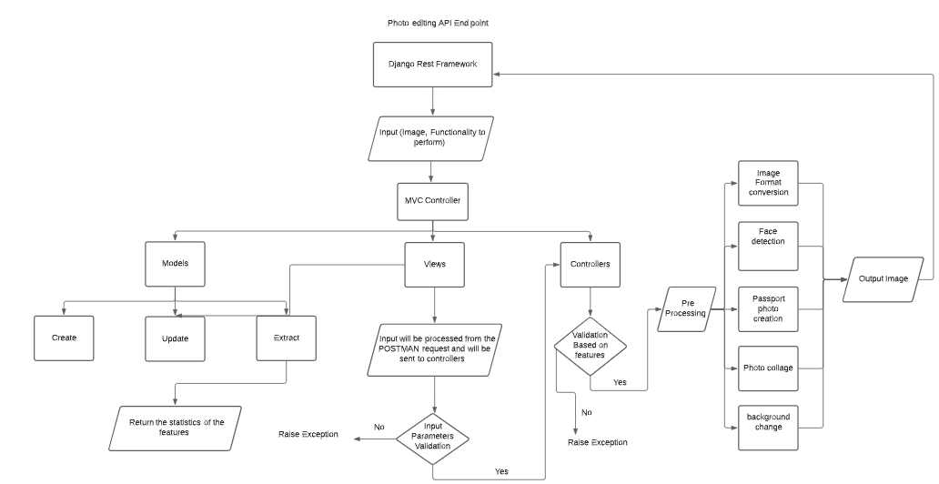
Technical Architecture
9

Slide 10
Technical Design Diagram Components
Routing:
Routing Engine – a pattern matching systems between incoming requests to response
End points – a communication channel between UI and core internal logic.
Processing:
Opencv library – For image processing such as Image resizing, Image cropping, Facial detection and so on.
10

Slide 11
Technical Design
Input/Output:
Upload - Users can upload any image of format .jpg, .png from their local device/IBM Cloud.
Download – Users can download images post editing.
11

Slide 12
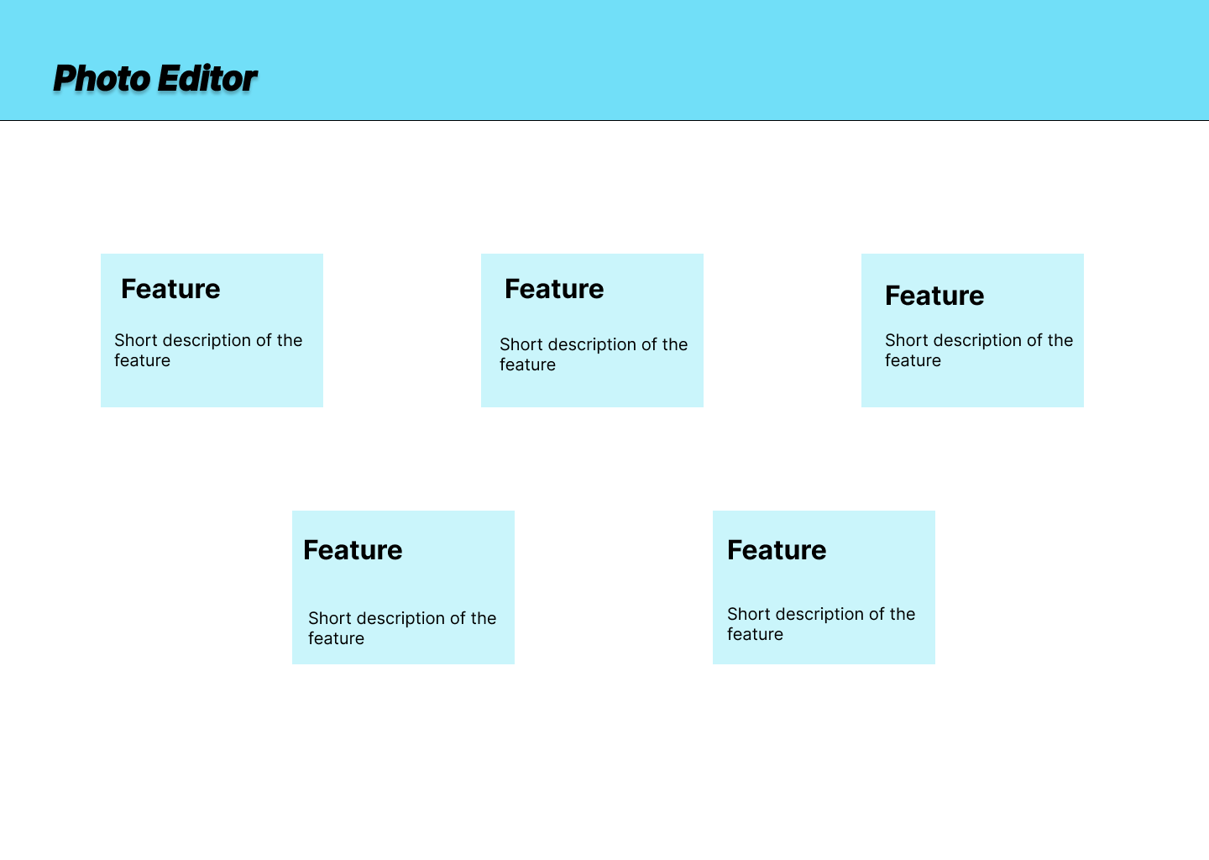
Wireframe
12

Slide 13
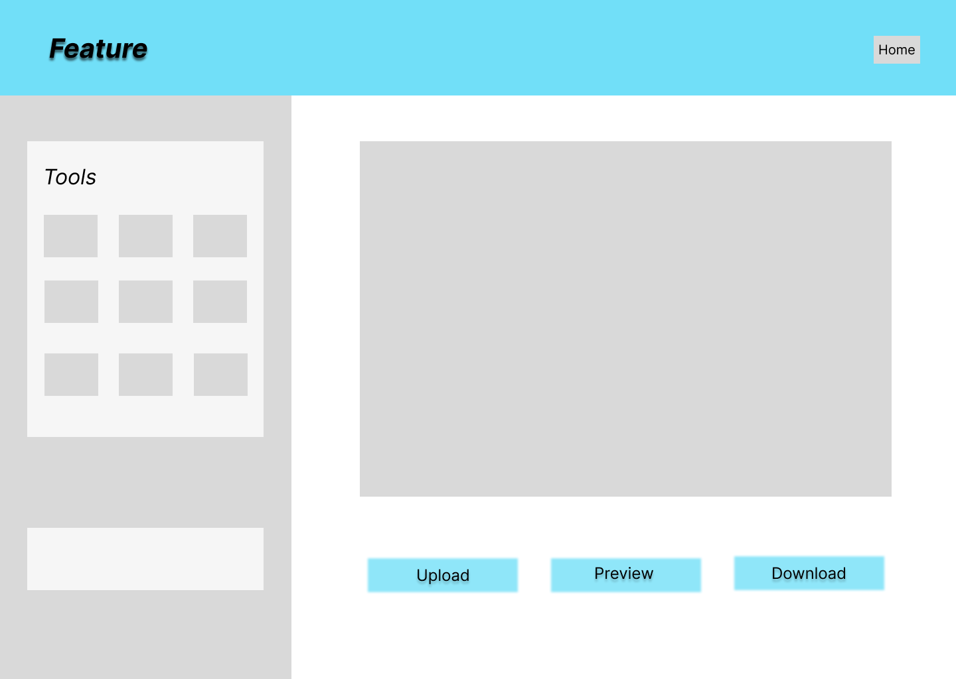
Wireframe
13

Slide 14
Wireframes Contd…
The above wireframes show the skeleton of how User Interface eventually looks like.
The relative positioning of the different components in home page and feature pages are shown for Photo Editor in previous slides.
The main page shows multiple cards with features and simple explanation of what the feature does.
Selecting any of the cards navigates to the feature page where respective options are on the left and image upload option is on the right.
This also provides user with options like Upload (upload new image), Preview (shows the final output after feature is selected) and Download (download image on the system).
Notes:
14

Slide 15
Sample Passport photo size requirements
The basic passport photograph requirements for some countries are as follows:
The United States: 2” x 2”
Canada: 5cm x 7cm.
Mexico: 2” x 2”.
United Kingdom: 4.5cm x 3.5cm.
Germany: 4.5cm x 3.5cm.
France: 4.5cm x 3.5cm.
Italy: 4.5cm x 3.5cm
Spain: 4cm x 3cm
·Russia: 4.5cm x 3.5cm.
Turkey: 4.5cm x 3.5cm
Netherlands: 4.5cm x 3.5cm.
Australia: 4.5cm x 3.5cm.
China: 4.8cm x 4.3cm
Japan: 4.5cm x 3.5cm
India: 3.5cm x 3.5cm
Singapore: 4.5cm x 3.5cm.Korea: 4.5cm x3.5cm
Brazil: 7cm x 5cm.
Notes:
15

Slide 16
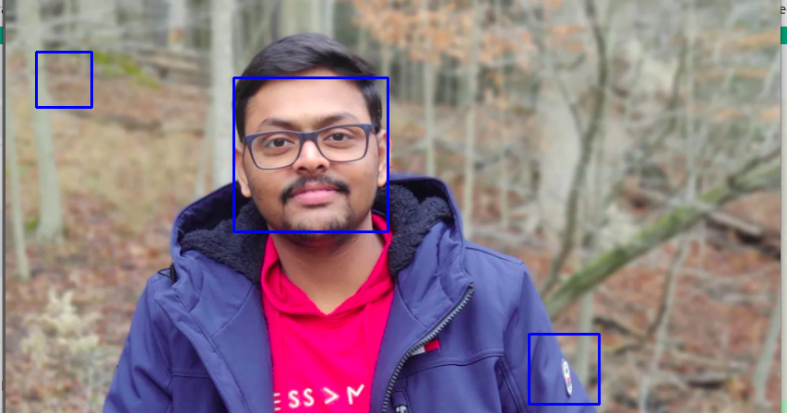
Notes:
16

Slide 17
Thank you
Notes:
17

